Slide 1
Mathematical Skills and Economic Development
Eric A. Hanushek
Stanford University
August 2014
Mathematics in Emerging Nations:
Achievements and Opportunities (MENAO) Symposium
Seoul, Korea

Slide 2
Introduction
Development = growth
LR growth is not a secret: skills or human capital
Start with challenges and go to solutions

Slide 3
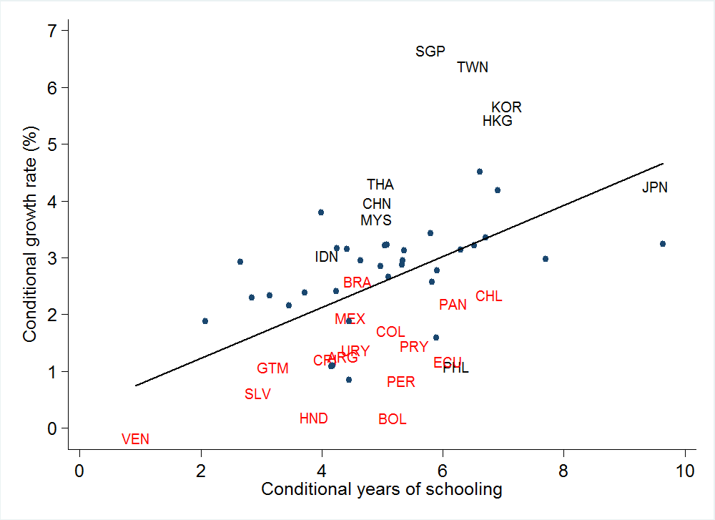
Growth and years of schooling, 1960-2000
East Asian miracle
Latin American growth puzzle

Slide 4
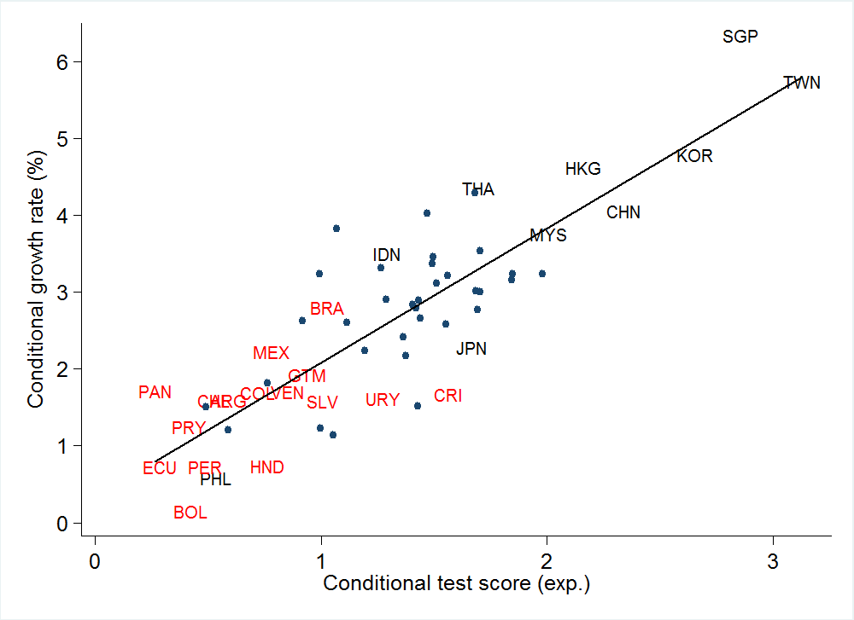
Growth and test scores

Slide 5
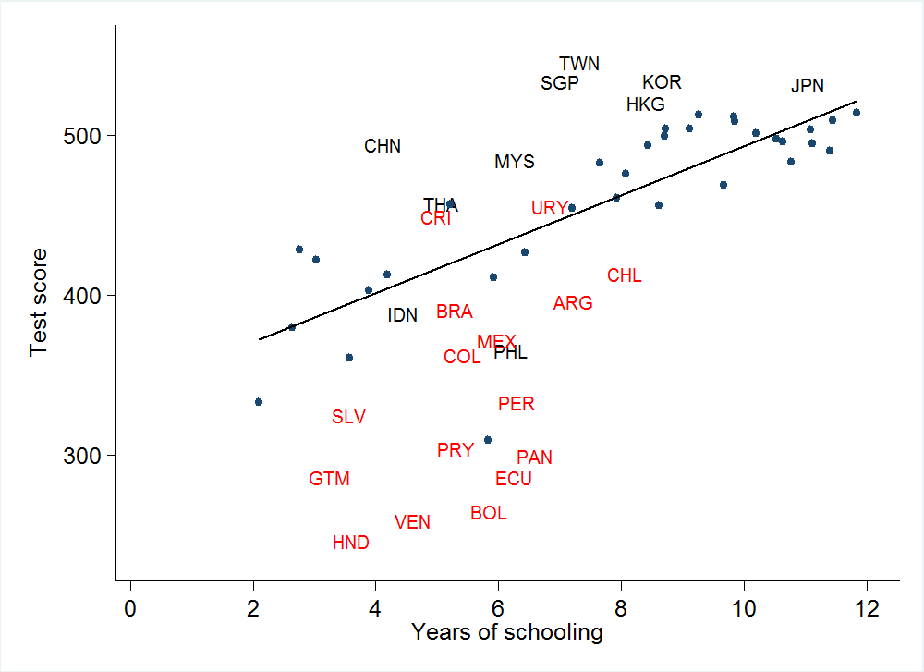
Schooling and achievement (Latin America, East Asia, and the world)

Slide 6
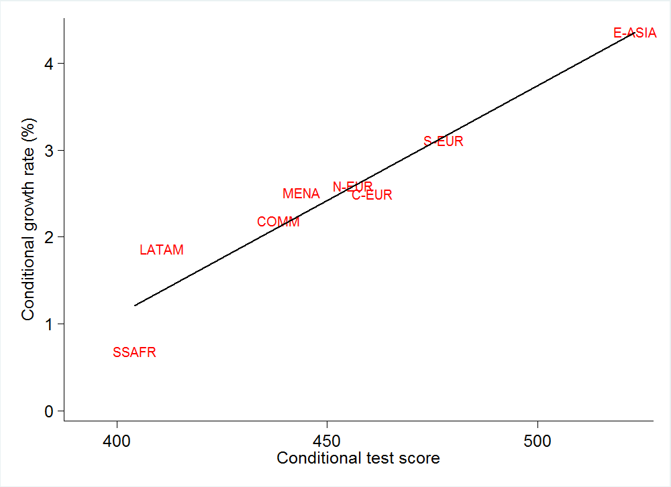
Knowledge capital and economic growth rates (GDP per capita, 1960-2009)

Slide 7
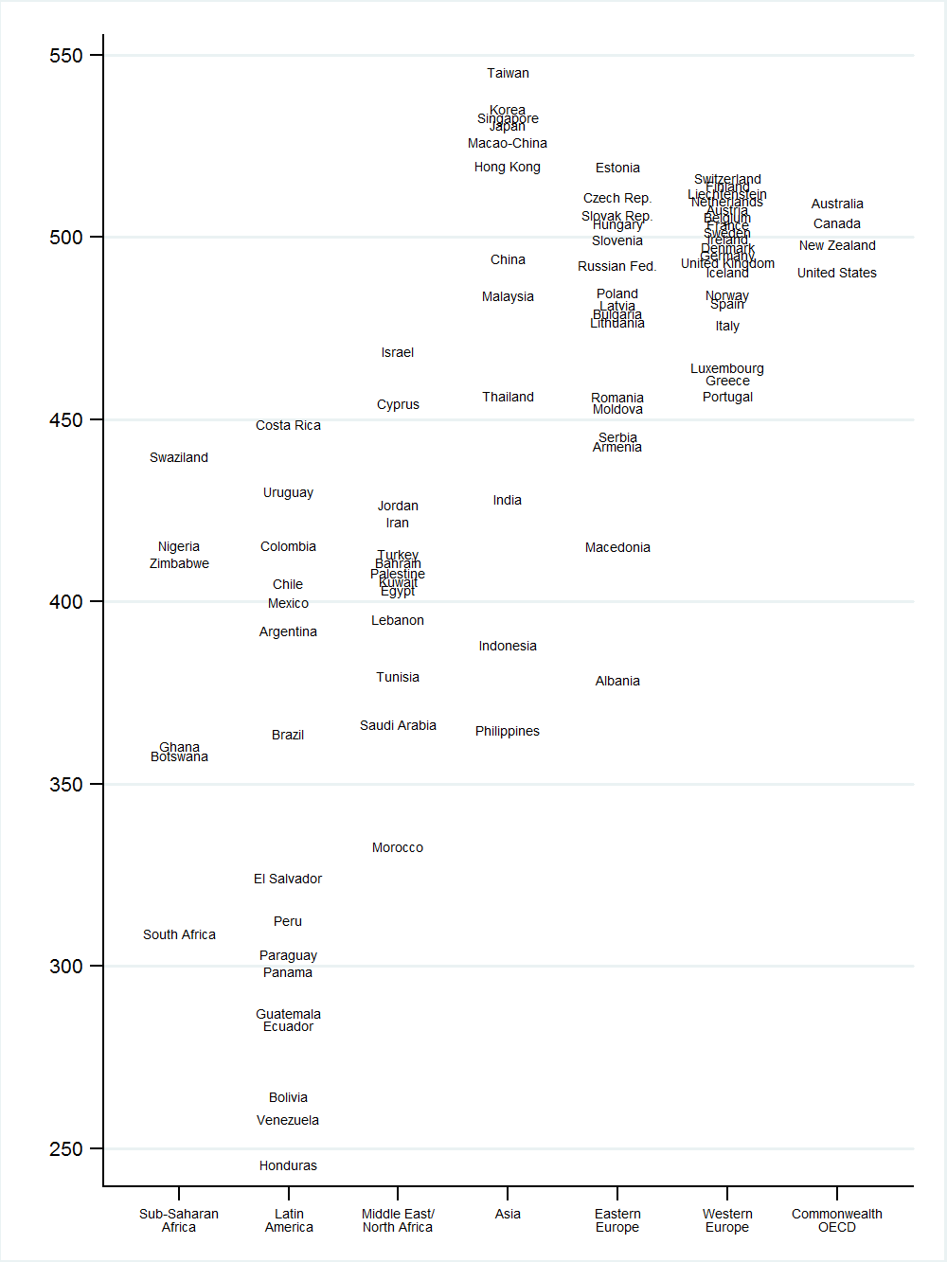
Average performance on international student achievement tests by region

Slide 8
Example of Value of Improvement
Assuming historical patterns hold
Present value over 80 years
Brazil moves to Trinadad-Tobago, Mexico level

Slide 9
PISA Math Performance 2009
25 PISA points

Slide 10
Example of Value of Improvement
Assuming historical patterns hold
Present value over 80 years
Brazil moves to Trinadad-Tobago, Mexico level
Present value of 270% of GDP
Average 6% higher GDP/pop for 80 years
12% higher paychecks for all workers every year

Slide 11
Improvement is Possible
Feasible: Brazil and Chile have made these gains in past
Other countries have improved

Slide 12
Achievement Growth, 1995-2009
Notes:
Drops 7 negative including France and Norway

Slide 13
Trends in Test Scores

Slide 14
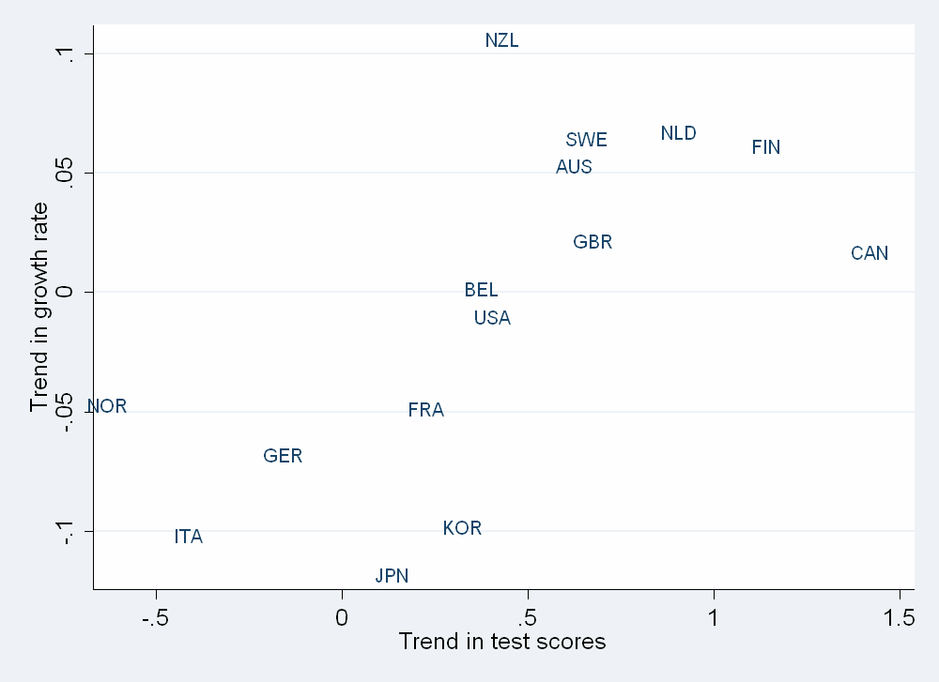
Trends in Growth Rates vs. Trends in Test Scores

Slide 15
Conclusions on Economic Impacts
Powerful effects of cognitive skills
Support for causal interpretation
Developing countries is much worse than generally pictured

Slide 16
Schooling and Literacy: Brazil
Fully Literate
8%
Grade 9
22 %

Slide 17
Schooling and Literacy: Peru
Grade 9
60 %
Fully Literate
12%

Slide 18
Schooling and Literacy: Ghana
Grade 9
37 %
Fully literate
5%

Slide 19
Schooling and Literacy: Columbia
Fully Literate
30%
Grade 9
49 %

Slide 20
Resource Policies
Little evidence of success
Cross country evidence
Within country – developed
Within country – developing

Slide 21
Resources and Performance across Countries
R ² = 0.01
R ² = 0.15
Notes:
Pro tracking:
Teachers do not have to worry about boring the fastest learners or losing the slowest learners
Contra tracking (pro ungrouped classrooms):
Concern: lower groups will be systematically disadvantaged by slower learning environments
If preparation on entry into school related to socio-economic background → continuing bias against more disadvantaged students

Slide 22
Resource Policies
Little evidence of success
Cross country evidence
Within country – developed
Within country – developing
Does not say “resources never have effect”
Does not say “resources cannot have effect”
No expectation within current incentive structure

Slide 23
Teacher Quality
Teachers most important input
No identifiable characteristics
Master’s degrees
Experience*
Certification
Preparation
Professional development
Observable through both student performance and supervisor ratings
Cannot regulate and pay on characteristics

Slide 24
Mathematics Instruction in Rural N.E. Brazil
Subject Matter Knowledge
Math and Portuguese Scores
Higher teacher subject matter knowledge is important
More important in math
But not everything!

Slide 25
Key Element – Focus on Outcomes
Input policies ineffective (spending, attendance, iPads, etc)
Cash transfers and demand side
“success” unclear
Must measure outcomes
Substantial evidence on teacher effectiveness
Not easily regulated (degrees, experience, certification)
U.S. debate: evaluations and teacher contracts (e.g., DC)
Hard to change teachers directly

Slide 26
Incentives and institutions
Accountability
Competition and choice
Urban markets
Private options
Performance rewards
Autonomy (??)

Slide 27
Technology and innovation
Differing views
Complement teachers
Substitute for teachers
Replace teachers
Do not understand incentive structure well
Getting teacher buy-in
Getting policy maker support
Potential importance of local circumstances
Importance of evaluation

Slide 28
Conclusions
Must focus on achievement and outcomes
Long run economic future linked to skills
Improvements are possible
Improvements are difficult
Key is incentives
To obtain and retain effective teachers
To introduce new innovations and technology
Need evaluation to promote continuous improvement

