Slide 1



Come and be counted at
ICME-15
7-14 July 2024 • ICC Sydney, Australia

Slide 2

ICME: The International Congress on Mathematical Education
ICME is the largest international conference on mathematics education in the world.
Held every leap year, ICME attracts over 3,000 delegates from around the world to explore current global trends in mathematics education research and mathematics teaching practices at all levels.
The first ICME was held in 1969 at the initiative of Hans Freudenthal, President of the International Commission on Mathematical Instruction (ICMI). They continue to be organised with the help and support of ICMI to this day.
icme15.org

Slide 3

ICME-15
In July 2024 Australia will host the 15th International Congress on Mathematical Education at the International Convention Centre, Sydney.
ICME-15 will be the first time that the international mathematics education community can come together to learn, share, and connect over their shared passion for mathematics and statistics education in person since 2016.
icme15.org

Slide 4

icme15.org
Who should attend ICME-15?
ICME-15 is for everyone involved or interested in mathematics education: mathematicians, researchers, teachers at all levels, teacher educators, administrators, curriculum developers, and resource producers.
ICME-15 is a unique opportunity for the Asia-Pacific region in particular to connect with the global mathematics education community – the last time ICME was held in the southern hemisphere was 1984, in Adelaide.
icme15.org

Slide 5





Informative and provocative talks from established and emerging thought leaders from around the world, survey reports of ‘hot topics’, and National Presentations that highlight unique achievements and challenges in mathematics education.
54 Topic Study Groups (TSGs) covering an extensive range of topics on mathematics education. Delegates can attend their choice of two TSGs, and each is like a mini-conference with five hours of sharing, discussion, and collaborative work held over four sessions across the Congress.
ICME-15 Program
Vibrant and innovative Discussion Groups and reimagined interactive Workshops, proposed and run by ICME-15 delegates.
Bespoke Early Career Research Program that provides early career researchers with opportunities to develop their individual research competencies, meet and work with international experts, and grow their network.
icme15.org

Slide 6
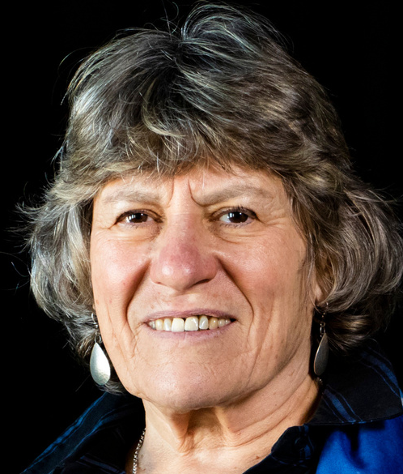
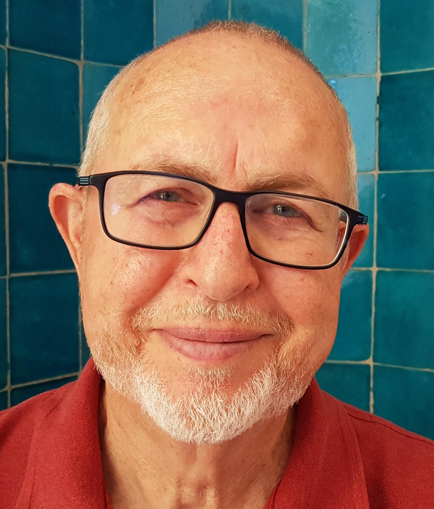
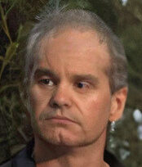
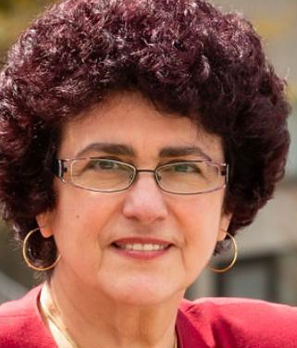
Plenary Speakers
Jill Adler
Iddo Gal
Jason Sharples
Rina Zazkis
University of the Witwatersrand
South Africa
University of Haifa
Israel
University of New South Wales
Australia
Simon Fraser University
Canada
icme15.org

Slide 7


Topic Study Group highlights
Examine the role of Indigenous mathematics in the learning and teaching of arithmetic and number systems in TSG 1.1: Teaching and learning of number and arithmetic.
Explore professional development models for inclusive teaching for in-service teachers, interventionists, teacher aides and mathematics coaches in TSG 2.1 Mathematics education for students with special learning needs.
Learn about the role of emerging devices (wearables, smartphones, graphics tablets and haptic devices) and technologies (artificially intelligent learning platforms, extended, virtual and augmented reality environments) in TSG 3.8: The role and the use of technology in the teaching and learning of mathematics at upper secondary and tertiary level.
icme15.org

Slide 8

Investigate the role of task design in promoting higher order thinking, and the role of cultural context in task design, in TSG 3.11: Task design and analysis.
Understand how different perspectives, political agendas, and policies can influence the status and preparation of early childhood and primary school mathematics teachers in TSG 4.1: Preservice mathematics teacher education for the early childhood/primary level
Discover innovative models of mathematics teacher professional development, like hybrid models resulting from the COVID-19 pandemic and new formats that integrate technology, in TSG 4.4: In-service mathematics teacher education and mathematics teacher professional development (Secondary).
Discuss how mathematics and mathematics education can advance racial, economic, cultural, and gender projects for social justice in TSG 5.5: Social and political dimensions of mathematics education.
icme15.org

Slide 9
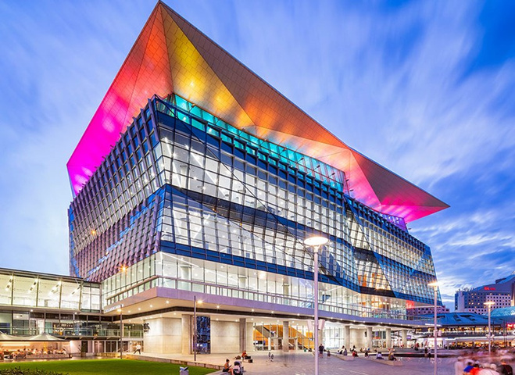


The ICME-15 experience
An accessible and environmentally-friendly Congress at the International Convention Centre: the heart of Sydney’s academic, cultural and technology precincts
An interactive, relevant, and dynamic exhibition with hands-on demonstrations and presentations that builds on the well-established ICME program
Unique experiences for delegates to create meaningful and lasting connections whilst enjoying the highlights of Sydney and its surrounds
icme15.org

Slide 10
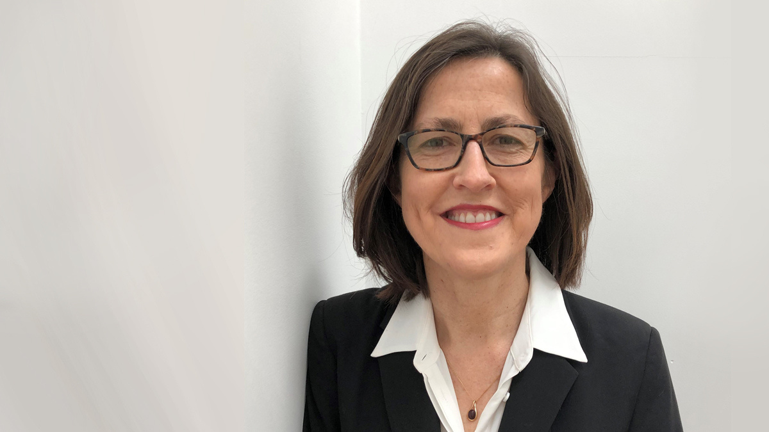


Your invitation to ICME-15
ICME-15 will be an inclusive event where people who are passionate about mathematics and statistics education can come together to connect with like-minded colleagues from around the globe and create lasting local, regional, and global legacies in our field.
We can't wait to see you in Sydney in 2024 - come and be counted!
Kim Beswick
ICME-15 Convenor
ICME-15 International Program Committee Chair
icme15.org

Slide 11

How will you be counted?
Promote ICME-15 in your networks, and share ICME-15 posters and flyers in your staff room and common areas
Submit a proposal to run a Workshop or a Discussion Group before December 31 2023
Encourage colleagues to submit proposals to ensure the good work of your organisation or school is showcased at ICME-15
Volunteer to assist the ICME-15 Local Organising Committee with Congress preparations, or during the event itself
Register for the Congress before 31 March 2024 and take advantage of early bird pricing
icme15.org

Slide 12















Email the team at
Hosted by
info@icme-15.org
Visit the website
https://icme15.org
Supporters
Contact information
Acknowledgement of Country
We acknowledge the Traditional Owners of the lands and waters throughout Australia, and pay respect to the Elders past, present and emerging
Foundation Sponsors
icme15.org

